Slide 1
Periodic Trends
Elemental Properties and Patterns

Slide 2
The Periodic Law
Atoms with similar properties appear in groups or families (vertical columns) on the periodic table.
They are similar because they all have the same number of valence (outer shell) electrons, which governs their chemical behavior.

Slide 3
Effective Nuclear Charge
What keeps electrons from simply flying off into space?
Effective nuclear charge is the pull that an electron “feels” from the nucleus.
The closer an electron is to the nucleus, the more pull it feels.
As effective nuclear charge increases, the electron cloud is pulled in tighter.

Slide 4
Shielding
As more Periodic Energy Levels are added to atoms, the inner layers of electrons shield the outer electrons from the nucleus.
The effective nuclear charge (enc) on those outer electrons is less, and so the outer electrons are less tightly held.
Shielding increases as you go down a group

Slide 5
Group A Elements
Your group A elements are known as the representative they are representative of elements with s and p orbitals filling up to 8 valence electrons. This plays a major role in element behavior as you will see in bonding. We refer to the elements in s and p orbitals as the Representative elements.
Ding Ding Ding!

Slide 6
Atomic Radius
The trend for atomic radius in a vertical column is to go from smaller at the top to larger at the bottom of the family.
Why?
With each step down the family, we add an entirely new PEL to the electron cloud, making the atoms larger with each step.

Slide 7
Atomic Radius
The trend across a horizontal period is less obvious.
What happens to atomic structure as we step from left to right?
Each step adds a proton and an electron (and 1 or 2 neutrons).
Electrons are added to existing PELs or sublevels.

Slide 8
Atomic Radius
The effect is that the more positive nucleus has a greater pull on the electron cloud.
The nucleus is more positive and the electron cloud is more negative.
The increased attraction pulls the cloud in, making atoms smaller as we move from left to right across a period.

Slide 9
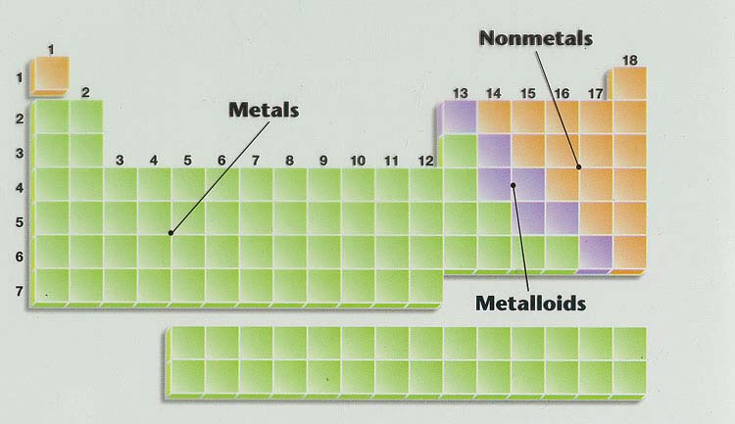
Atomic Radius
Increases down a group
Decreases across a period

Slide 10
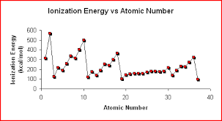

Slide 11
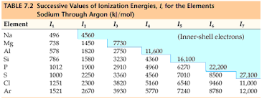
Ionization Energy Chart

Slide 12
Ionization Energy
If an electron is given enough energy (in the form of a photon) to overcome the effective nuclear charge holding the electron in the cloud, it can leave the atom completely.
The atom has been “ionized” or charged.
The number of protons and electrons is no longer equal.

Slide 13
Ionization Energy
The energy required to remove an electron from an atom is ionization energy. (measured in kilojoules, kJ)
The larger the atom is, the easier its electrons are to remove.
Ionization energy and atomic radius are inversely proportional.
Ionization energy is always endothermic, that is energy is added to the atom to remove the electron.

Slide 14
Ionization Energy
Timed Pair Share: Explain why each
Decreases down a group
Increases across a period

Slide 15
Ionization Energy
Successive Ionization Energies
Large jump in I.E. occurs when a CORE e⁻ is removed.
Mg 1st I.E. 736 kJ
2nd I.E. 1,445 kJ
Core e⁻ 3rd I.E. 7,730 kJ

Slide 16
Ionization Energy
Successive Ionization Energies
Large jump in I.E. occurs when a CORE e⁻ is removed.
Al 1st I.E. 577 kJ
2nd I.E. 1,815 kJ
3rd I.E. 2,740 kJ
Core e⁻ 4th I.E. 11,600 kJ

Slide 17
Electron Affinity
What does the word ‘affinity’ mean?
Electron affinity is the energy change that occurs when an atom gains an electron (also measured in kJ).

Slide 18
Electronegativity
Electronegativity is a measure of an atom’s attraction for another atom’s electrons.
It is an arbitrary scale that ranges from 0 to 4.
The units of electronegativity are Paulings.
Noble Gases do not attract electrons from other atoms.

Slide 19
Electronegativity
Decrease down a group
Increases across a period
0

Slide 20
Overall Reactivity
The most reactive metals are the largest since they are the best electron givers.
The most reactive nonmetals are the smallest ones, the best electron takers.

Slide 21
Ions
When an atom gains an electron, it becomes negatively charged (more electrons than protons ) and is called an anion.
In the same way that nonmetal atoms can gain electrons, metal atoms can lose electrons.
They become positively charged cations.

Slide 22
Ionic Radius
Cations are always smaller than the original atom.
Conversely, anions are always larger than the original atom.

Slide 23
Cation Formation
Na atom
1 valence electron
Effective nuclear charge on remaining electrons increases.
11p+
Remaining e- are pulled in closer to the nucleus. Ionic size decreases.
Valence e- lost in ion formation
Result: a smaller sodium cation, Na⁺

Slide 24
Anion Formation
A chloride ion is produced. It is larger than the original atom.
Chlorine atom with 7 valence e-
17p+
One e- is added to the outer shell.
Effective nuclear charge is reduced and the e- cloud expands.

Slide 25
Ionic Radius

Slide 26
Examples
Which atom has the larger radius?
Be or Ba
Ca or Br
Ba
Ca

Slide 27
Examples
Which atom has the higher 1st I.E.?
N or Bi
Ba or Ne
N
Ne

Slide 28
Examples
Which particle has the larger radius?
S or S²⁻
Al or Al³⁺
S²⁻
Al

Slide 29
Kahoot Quiz!!

